Slide 1
ReSTful Web Services
420-C50 S20

Slide 2
ReST
REST stands for Representational State Transfer
It relies on a
Layered System
Uniform Interface
Stateless,
Client-Server,
Cacheable
Communications Protocol (HTTP protocol almost always)
Code on Demand (optional)

Slide 3
ReST is:
An architecture style for designing networked applications
Rather than using complex architectures, use simple HTTP calls between machines
NOT standard – there will never be a W3C standard for ReST

Slide 4
Lightweight Web Services
Like all web services
Platform-independent (you don't care about the server),
Language-independent (C# can talk to Java, etc.),
Standards-based (runs on top of HTTP), and
Can easily be used in the presence of firewalls

Slide 5
What It Doesn’t Have
No built-in security features, encryption, session management, QoS guarantees
Build these on top of HTTP
Username/password tokens
Can run on top of HTTPS
No cookies
State Transfer means each operation is self-contained and each request carries all the required information

Slide 6
How Simple Is It?
Request for user information
SOAP
<?xml version="1.0"?> <soap:Envelope xmlns:soap="http://www.w3.org/2001/12/soap-envelope" soap:encodingStyle="http://www.w3.org/2001/12/soap-encoding"> <soap:body pb="http://www.acme.com/phonebook"> <pb:GetUserDetails> <pb:UserID>12345</pb:UserID </pb:GetUserDetails> </soap:Body> </soap:Envelope>
ReST
http://www.acme.com/phonebook/UserDetails/12345
Notes:
A nice analogy for REST vs. SOAP is mailing a letter: with SOAP, you're using an envelope; with REST, it's a postcard. Postcards are easier to handle (by the receiver), waste less paper (i.e., consume less bandwidth), and have a short content. (Of course, REST requests aren't really limited in length, esp. if they use POST rather than GET.)

Slide 7
More Complex ReST Requests
Add parameters in query string
http://www.acme.com/phonebook/UserDetails?firstName=John&lastName=Doe
Send using POST command
For long or binary parameters
To update, create or delete (only use GET for read)

Slide 8
Mapping your API actions onto HTTP methods
Mapping HTTP Methods provide CRUD methods
HTTP Method | CRUD | Example
GET | Retrieve information. GET requests must be safe and idempotent, meaning regardless of how many times it repeats with the same parameters, the results are the same. They can have side effects, but the user doesn't expect them, so they cannot be critical to the operation of the system. Requests can also be partial or conditional. | GET /addresses/1 (Get an address with ID of 1)
POST | Request that the resource at the URI do something with the provided entity. Often POST is used to create a new entity, but it can also be used to update an entity | POST /addresses (create new address)
PUT | Store an entity at a URI. PUT can create a new entity or update an existing one. A PUT request is idempotent. Idempotency is the main difference between the expectations of PUT versus a POST request. | PUT /addresses/1 (modify the address with an ID of 1)
PATCH | Update only the specified fields of an entity at a URI. A PATCH request is idempotent. Idempotency is the main difference between the expectations of PUT versus a POST request. | PATCH /addresses/1
DELETE | Request that a resource be removed; however, the resource does not have to be removed immediately. It could be an asynchronous or long-running request | DELETE /addresses/1 (Delete an address with an ID of 1)
Notes:
Source: https://spring.io/understanding/REST
In computer science, the term idempotent is used more comprehensively to describe an operation that will produce the same results if executed once or multiple times.^{[9]} This may have a different meaning depending on the context in which it is applied. In the case of methods or subroutine calls with side effects, for instance, it means that the modified state remains the same after the first call. In functional programming, though, an idempotent function is one that has the property f(f(x)) = f(x) for any value x.^{[10]}
This is a very useful property in many situations, as it means that an operation can be repeated or retried as often as necessary without causing unintended effects. With non-idempotent operations, the algorithm may have to keep track of whether the operation was already performed or not.

Slide 9
Return codes -> HTTP Response codes
1XX - informational
2XX - success
3XX - redirection
4XX - client error
5XX - server error

Slide 10
Good Practice
Use GET request to read data
Use POST request to create, update and delete
Use POST for longer parameters
Use XML (or JSON) in response but rarely in request
Request parameters are simple so no need for overhead of XML
ReST is not bound to XML, can return any format (JSON popular, especially for mobile)
Don’t return ‘human consumable content’ like HTML
Notes:
Examples: Google glass (Mirror API); Twitter; Flickr; Instagram; Amazon
Tesla Model S undocumented REST between car system and Android Apps tp control car systems
Best practices: https://solidgeargroup.com/best-practices-rest-api

Slide 11
ReST Design Guidelines
Do not use “physical” URLs that point to a specific file
Queries should not return an overload of data requiring paging, etc
Document output and don’t change it lightly
GET requests should never cause a state change

Slide 12
SOAP vs REST
SOAP advantages
More mature tool support
Type safety of XML in requests
ReST advantages
Ease of implementation
Agility of design
Lightweight approach (typically 25-40% less bandwidth than SOAP)
Performance is better

Slide 13
ReST Constraints
Uniform Interface
Simplified and decoupled
Resource based
Self-descriptive
Meta-data ready
Stateless
No state information stored so much be sent with each call (self-contained)
Client must always include all information to fulfill the request

Slide 14
ReST Constraints
Cacheable
All responses must define if they are cacheable
Well managed caching may partially eliminate some client-server interactions
Client-Server
Separation of concerns

Slide 15
ReST Constraints
Layered System
Client cannot tell if it is connected to the server
Helps with security policies
Code on Demand
Servers can extend or customise functionality
“Active” code like scripts or applets

Slide 16
Samples and hands on
Jsonplaceholder.typicode.com
Fake online REST API
Supplied example RestDemoSite
Class exercise
Page to list Users by user name, proper name and address (street, suite, city)
Uses the Jsonplaceholder fake REST API

Slide 17

Objectives
I want to offer my own REST API services…
How to do this?
Hands-on spoon feeding walk though

Slide 18
Class Exercise: Create a Simple Web Service
Starting point
An existing MVC project to extend (why not?)
C50S10 MVC project (list of students)
Nice GUI, but let’s add a REST API to it
For now, we’ll just do the list view as a public API similar to what the StudentController.Index() returns
Steps to learn:
Add a new REST Controller
Notes:
Walkthrough what C50S10 looks like as a starting point.

Slide 19
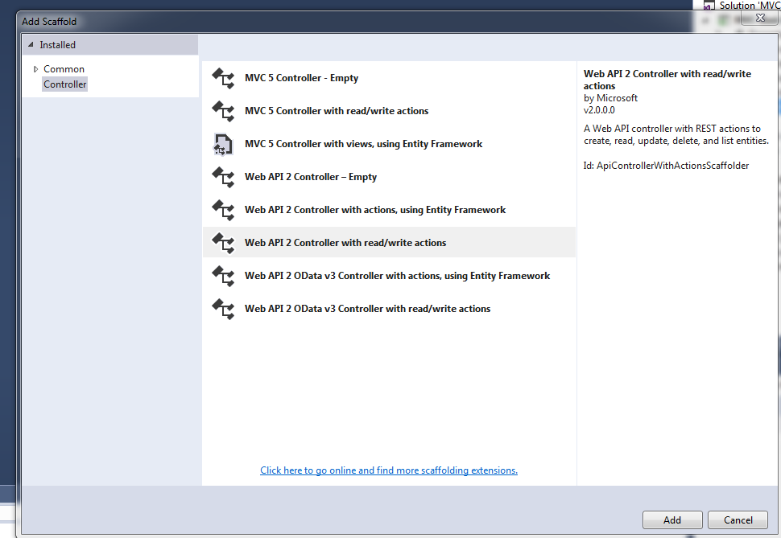
Class Exercise: Create a Simple Web Service
Steps to learn:
Add a new REST Controller “StudentWebController”
Notes:
Walkthrough what C50S10 looks like as a starting point.

Slide 20
Class Exercise: Create a Simple Web Service
Follow the readme.txt instructions for updating Global.asax.cs
If Global.asax.cs is not setup properly, you might have problems routing URIs to your controller (see slide note)
Note new scaffolded “StudentWebController”
Update the Get api/StudentWeb to return a list of student information.
Notes:
Try your URL /api/StudentWeb
Note output is in XML
public IEnumerable<Models.Student> Get()
{
return Models.StudentList.Instance.GetList();
}
Reference: https://docs.microsoft.com/en-us/aspnet/web-api/overview/advanced/configuring-aspnet-web-api
Gkivak,asax,cs should have
System.Web.Http.GlobalConfiguration.Configure(WebApiConfig.Register);
// where WebApiConfig is defined in AppStart/WebApiConfig if the register method is not referenced, you won’t route to you Web controller
In AppStart/WebApiConfig:
public static class WebApiConfig
{
public static void Register(HttpConfiguration config)
{
config.MapHttpAttributeRoutes();
config.Routes.MapHttpRoute(
name: "DefaultApi",
routeTemplate: "api/{controller}/{id}",
defaults: new { id = RouteParameter.Optional }
);
}
}
In Global.asax:
public class Global : HttpApplication
{
void Application_Start(object sender, EventArgs e)
{
GlobalConfiguration.Configure(WebApiConfig.Register);
// Code that runs on application startup
RouteConfig.RegisterRoutes(RouteTable.Routes);
BundleConfig.RegisterBundles(BundleTable.Bundles);
}
}

Slide 21
ApiController common response types
Method
Ok() | Creates an OkResult (200 OK)
NotFound | Creates a NotFoundResult
Json<T>(T) | Creates a JsonResult<T>(200 OK) with the specified value
Notes:
Try your URL /api/StudentWeb/6
Note output is in XML
public IHttpActionResult Get(int id)
{
var studentFound = Models.StudentList.Instance.FindStudent(id);
if (studentFound == null)
{
return NotFound();
}
return Ok(studentFound);
}

Slide 22
Class Exercise: My Solution
namespace MVC_BasicTutorials.Controllers
{
public class StudentWebController : ApiController
{
// GET: api/StudentWeb
/**
public IEnumerable<Models.Student> Get()
{
return Models.StudentList.Instance.GetList(); // returns XML
}
**/
public IHttpActionResult Get()
{
return Json<IEnumerable<Models.Student>>(Models.StudentList.Instance.GetList());
}
// GET: api/StudentWeb/5
public IHttpActionResult Get(int id)
{
var studentFound = Models.StudentList.Instance.FindStudent(id);
if (studentFound == null)
{
return NotFound();
}
//return Json<Models.Student>(studentFound); for json result
return Ok(studentFound); // xml result
}
Notes:
Try your URL /api/StudentWeb/6
Note output is in XML, figure out how to get it in JSON
public IHttpActionResult Get(int id)
{
var studentFound = Models.StudentList.Instance.FindStudent(id);
if (studentFound == null)
{
return NotFound();
}
return Ok(studentFound);
}

Slide 23
Class Exercise: Create a Simple Web Service
Routing notes: defaulting routes can be overridden and you can specify which HTTP verb triggers which method rather than being fixed to actions called Get, Post, Put, Delete
public class ProductsController : ApiController
{
[HttpGet]
[ActionName("Thumbnail")]
public HttpResponseMessage GetThumbnailImage(int id);
[HttpPost]
[ActionName("Thumbnail")]
public void AddThumbnailImage(int id);
}
Notes:
Try your URL /api/StudentWeb/6
Note output is in XML
public IHttpActionResult Get(int id)
{
var studentFound = Models.StudentList.Instance.FindStudent(id);
if (studentFound == null)
{
return NotFound();
}
return Ok(studentFound);
}

Slide 24

Class Activity – post activity
Consider what you’ve done:
Controllers provide a way of building your own REST APIs
Design message types to be in XML, JSON or string formats if you like
How cool is that?!
Notes:
You’ve just built your own REST API!! Cool huh?

Slide 25
References
MSDN REST Guide
Introduction to REST
REST vs SOAP discussions
Building RESTful APIs with ASP.NET
Getting Started with ASP.NET Web API 2

